Slide 1

Basic Python and introduction to neural nets
And a little bit of history

Slide 2
Some slides introducing AI in the hype era and difference between west east.

Slide 3
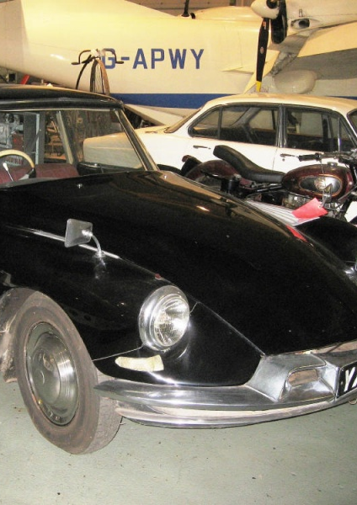
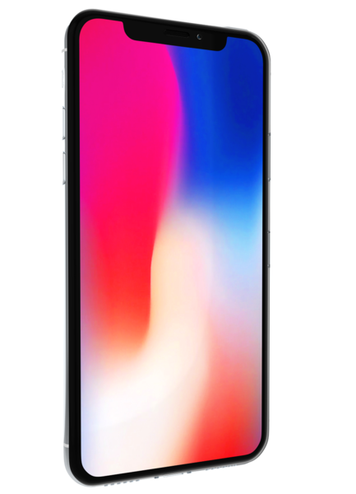
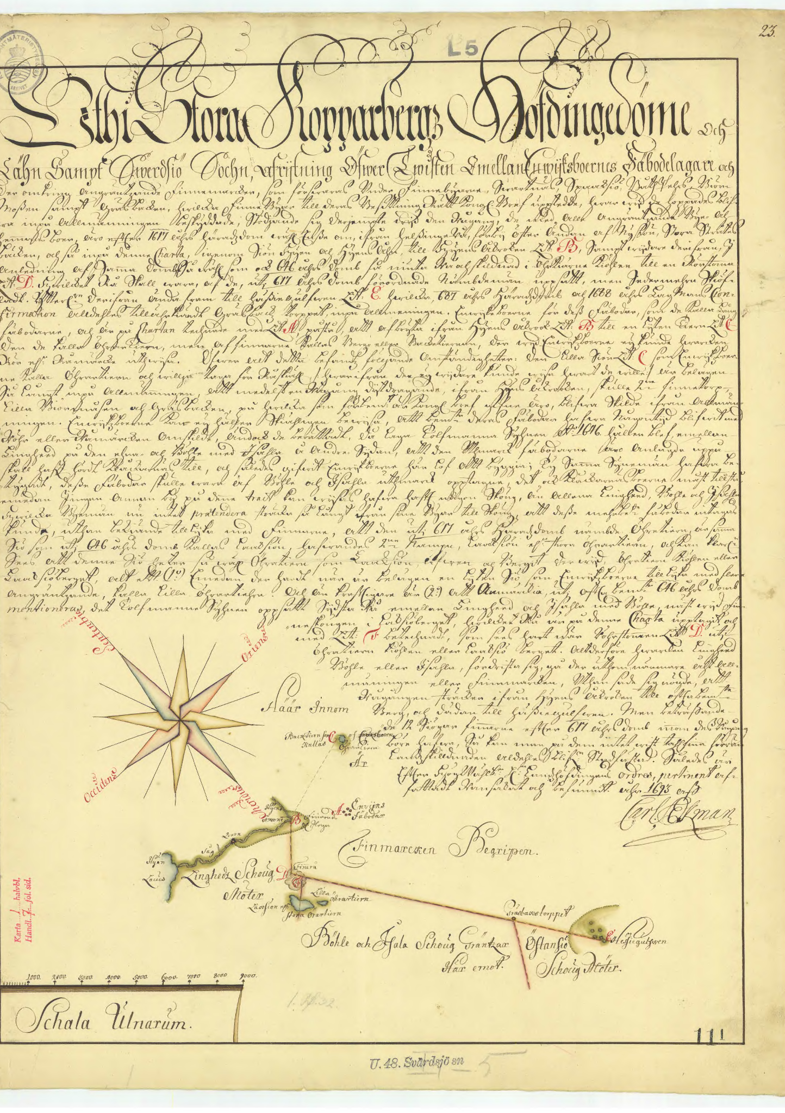
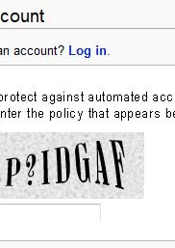
Use of AI
Notes:
For a quite

Slide 4
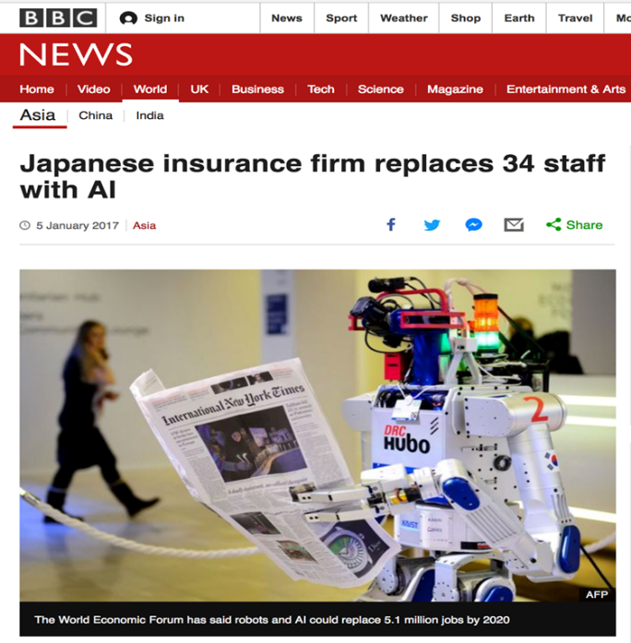
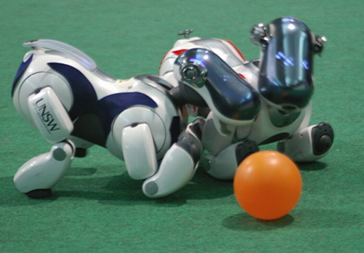
Notes:
For a quite

Slide 5
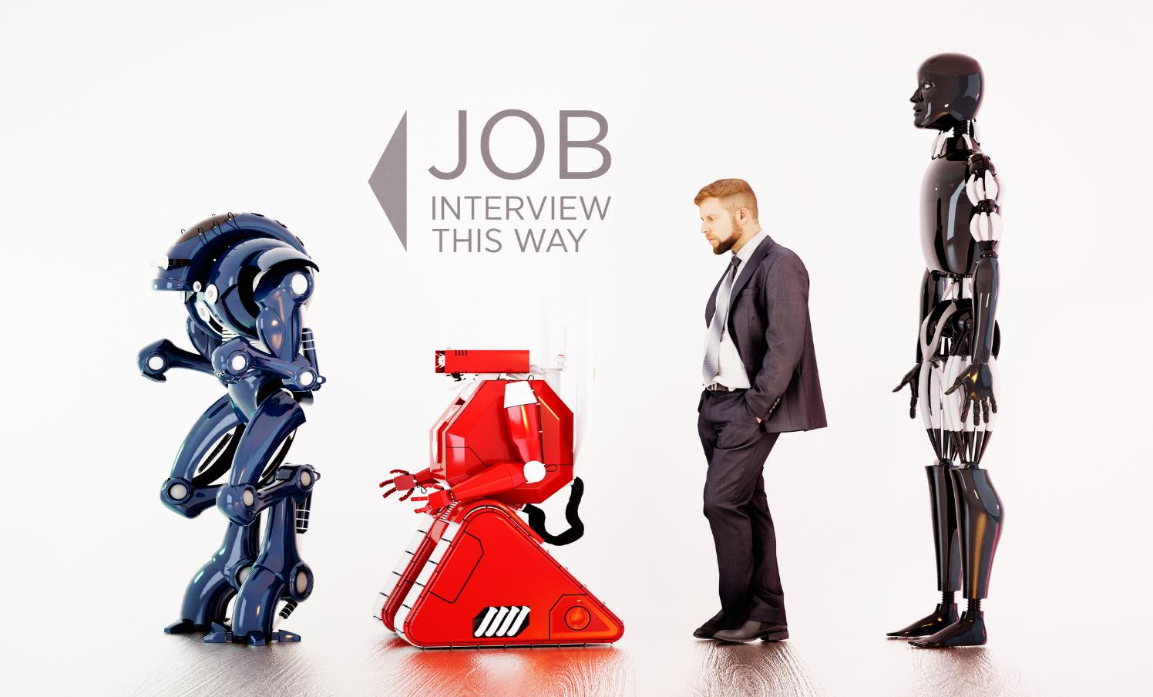
Notes:
Hur ser morgondagens arbetsmarknad ut
Skillnad Europa/USA och Japan

Slide 6
Some history might help us to understand the changes of the future

Slide 7
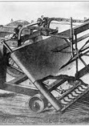
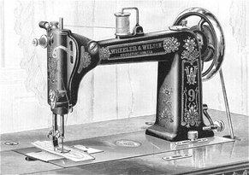
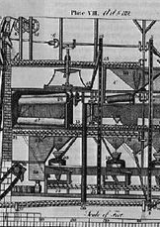
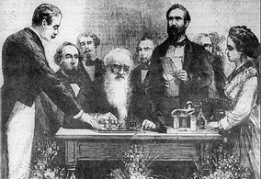
Industrial revolution
Notes:
Replacing muscles
Improve productability

Slide 8
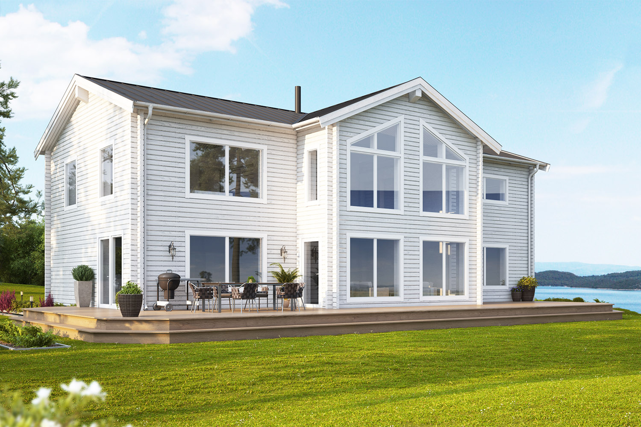
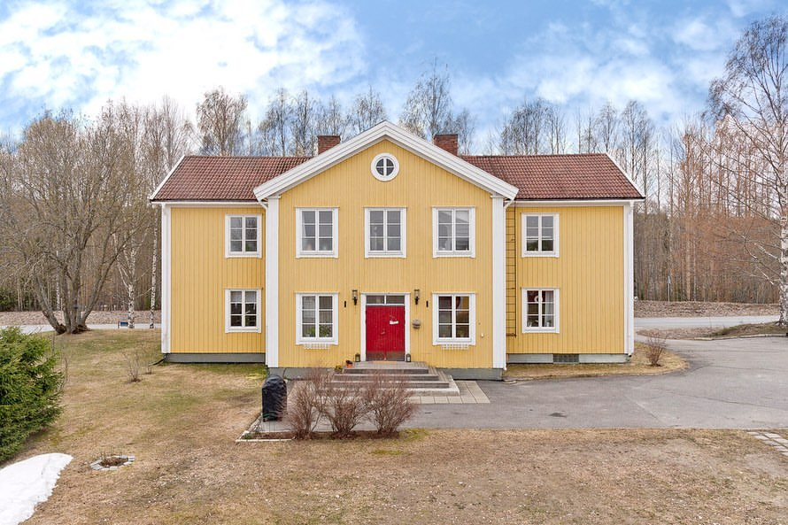
Electrification from an architects perspective The secondary effects
Notes:
For a quite

Slide 9
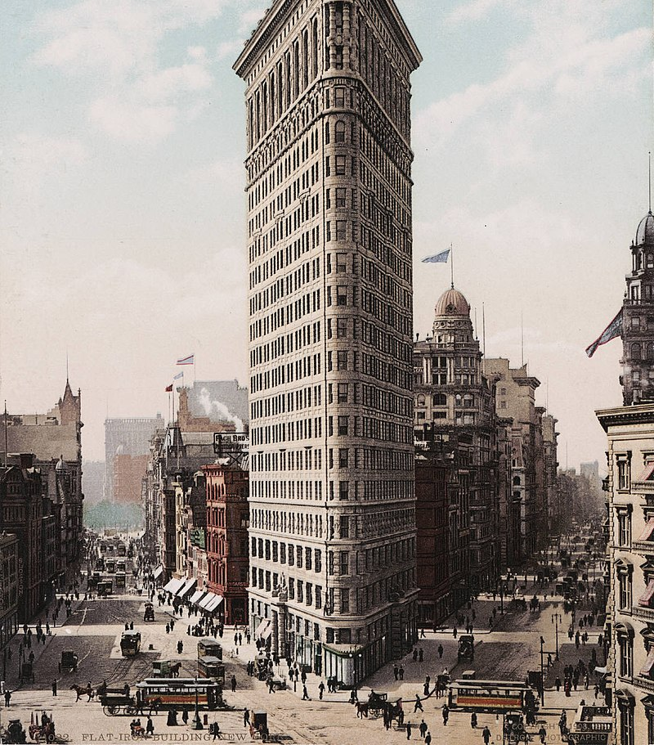
Skyscraper of the future

Slide 10
What is intelligence
Computers vs Humans

Slide 11

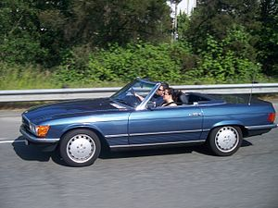
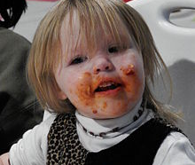
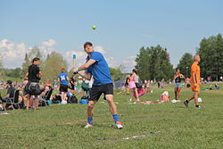
Intelligence Ability to learn
Notes:
For a quite

Slide 12
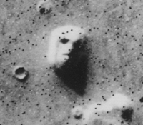
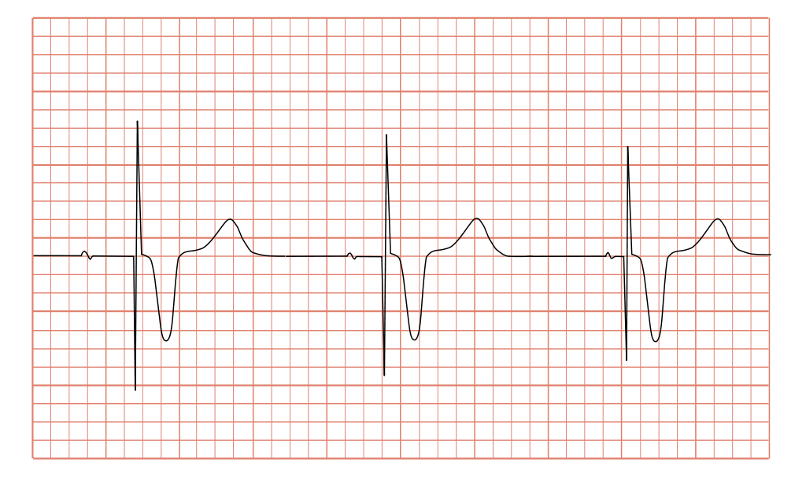
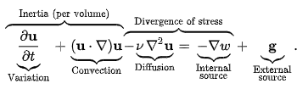
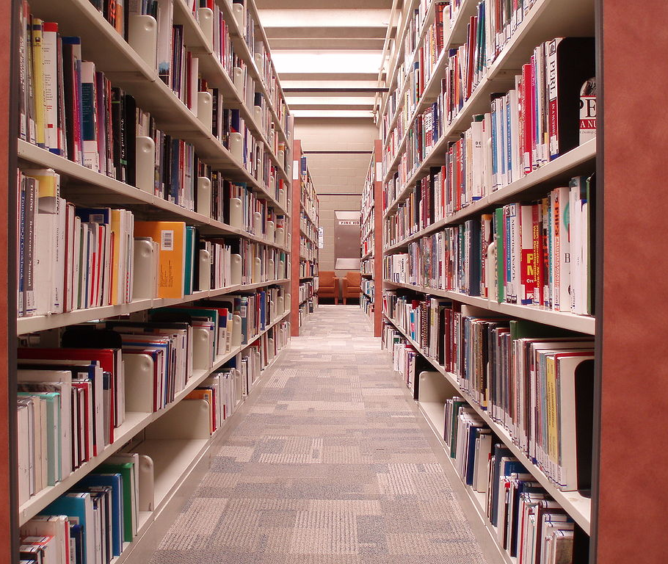
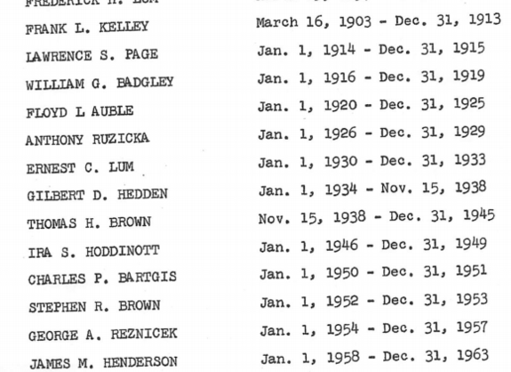
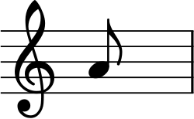
Intelligence Processing information
Notes:
Vad är datorn bra på, vad är vi bra på.

Slide 13
What is the difference between these tasks?
Humans are poor at computation
Exact, quantitative, inherently serial (although can sometimes be parallelised)‏
Very few people can compete with a computer for even simple calculations
Humans are excellent at pattern recognition and association and other higher cognitive tasks
Inexact, qualitative, inherently parallel
Enormous effort has been spent trying to get computers to emulate this human performance, with only limited success

Slide 14
Background (contd.)
The human brain is amazing!
Here are a few things that brains can do:
Recognise someone you haven’t seen for 10 years, even if they have changed
Guess that a piece of music is by a particular composer from its “style”
Understand speech, even if the person speaking has a strong regional dialect
Instinctively “fill in” missing information

Slide 15
For what kinds of task is pattern recognition important?
Computer vision
Electronic “noses”
ECG analysis
Biometrics
Face recognition
Fingerprint recognition
Handwriting analysis
OCR
Speech recognition
Security systems
Forensics
Fault detection
Seismic analysis
Friend/foe recognition
Signal processing

Slide 16
Magic of new methods
Humans tend to think that everything that new methods for problem solving are magic and therefor they must be intelligent.
Find a problem? Do not walk straight to NN and ML. Ask youself might someone before have had this generalized problem, who did, how did they solve it.

Slide 17
Lets do some coding!

Slide 18
From features to information…
Finally we have to classify or recognise
This is the pattern recognition task
How can we go about this?
Build an algorithm by hand?
Using formal syntax, e.g. grammars
Use a statistical method?
i.e. formulate a hypothesis and fit a model
Neither of these methods fits how the brain works….they are essentially computational methods which require some a priori information

Slide 19
….using a cognitive approach
The human brain solves these kind of problems in a cognitive way:
There is no explicit algorithm
A prioi “common sense” information is often used, but in an implict way
The method is clearly adaptive, as we learn over time
The hardware (the brain!) is pretty important and is not like a regular computer

Slide 20
Neural nets

Slide 21
Background
Why we don’t simply simulate humain’s brain ?
Car crash simulations
Aerodynamics of windmills
No governing equations
Does not really know how it works, but got a model.

Slide 22
Neural Nets
Artificial Neural Nets
All nodes connected to all nodes in next layer
Recurrent Neural Nets
With stream of data
Voice detection
Prediction of maintanence
Convolutional Neural Nets
Images

Slide 23
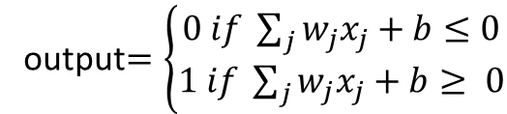
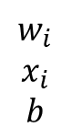
Perceptron
transfer function
output$=\left\{\begin{aligned}0 if \sum_{j}{w_{j}x_{j}+b≤0} \\ 1 if \sum_{j}{w_{j}x_{j}+b≥ 0}\end{aligned}\right.$
x₁
w₁
w₂
$$w_{i}$$
$$x_{i}$$
$$b$$
x₂
ƒ
Output
Inputs
x_{j}
w_{j}
weighted
connections

Slide 24
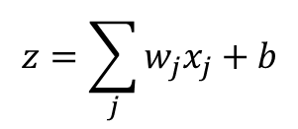
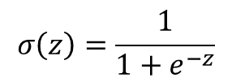
Neural Network
$$z=\sum_{j}{w_{j}x_{j}+b}$$
Input
Output
$$σ\left(z\right)=\frac{1}{1+e^{−z}}$$
Hidden

Slide 25
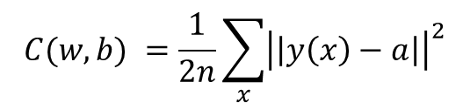
Training the network
Split data into train and test
Define a function to measure how good/bad our function is
Find weights and biases that minimises the cost for the problem
Obviously a very hard problem to solve. Numerical methods needed
$$C(w,b) =\frac{1}{2n}\sum_{x}{{\left|\left|y\left(x\right)−a\right|\right|}^{2}}$$

Slide 26
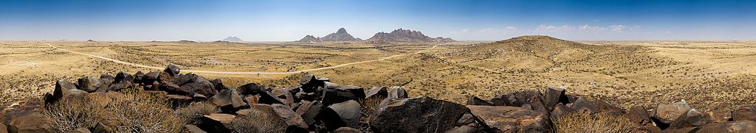
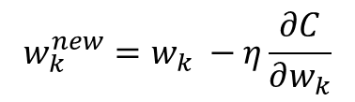
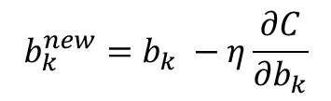
Minimizing Cost with Gradient Descent
$$w_{k}^{new}=w_{k} −η\frac{∂C}{∂w_{k}}$$
$$b_{k}^{new}=b_{k} −η\frac{∂C}{∂b_{k}}$$

Slide 27
Importance of Data

Slide 28
From raw data to features
The data must often be:
Cleaned, for example to detect periods of time where the sensor was not working properly
Sampled, for example particular frames selected from a video
We must then extract features
For example if we want to tell whether there is a traffic sign in a picture, we want to extract information which is relevant
looking for bright colours and geometrical shapes is clearly relevant
whether the picture is light or dark is not relevant
It is at this stage that information reduction happens

Slide 29
Sensors
We are not going to look at sensors and hardware signal processing in this course
We assume that data has been collected using a camera, microphone or some other apparatus and that analogue information has been digitised
A raw data set from a sensor is often very large and noisy

Slide 30
Python for data scientists

Slide 31
Why python
Simple to learn
Similar syntax to Matlab making switch simple for people used to scientific computing
Well developed libraries

Slide 32
How python
Developed with readability in focus
Indentation important
Non declarative
Object oriented, functional or precedural

Slide 33
Syntax and naming
# is used for starting a comment line
“““ Multi line comment “““
a = 1 # set a to 1
a += 1 # add 1 to a
c = a*a + a**2 # multiply and take the square
b = [0,2, ]
def func(val):
print(val)
func(9)

